Slide 1
DataSpark: Illuminating Retail Analytics for Global Electronics - Data-Driven Insights for Business Growth

Slide 2

The DataSpark: Illuminating Retail Analytics for Global Electronics project aims to leverage data analytics to drive business growth for Global Electronics, a leading retailer in the consumer electronics sector. By conducting a comprehensive Exploratory Data Analysis (EDA), our team seeks to uncover actionable insights from diverse datasets, including customer behavior, sales trends, and product performance. The insights gained will enhance marketing strategies, optimize inventory management, and improve customer satisfaction, positioning Global Electronics for sustained success in a competitive market.

Slide 3

Project overview
The DataSpark project focuses on performing an extensive Exploratory Data Analysis (EDA) for Global Electronics, a major consumer electronics retailer. The goal is to uncover valuable insights from datasets covering customers, sales, products, and stores. These insights will inform business strategies in areas such as marketing, inventory management, sales forecasting, and international pricing, while also improving customer satisfaction. The project involves data cleaning, SQL database management, and creating interactive visualizations in Power BI/Tableau to present key findings and recommendations for business growth.

Slide 4
Problem
Data Utilization: Global Electronics struggles to effectively leverage its extensive datasets for strategic decision-making.
Customer Insights: There is a lack of understanding of customer demographics and purchasing behaviors, limiting targeted marketing efforts.
Sales Optimization: The company needs insights into sales trends and product performance to enhance inventory management and forecasting.
Competitive Positioning: Without actionable insights, Global Electronics risks losing market share to competitors who effectively utilize data analytics.

Slide 5
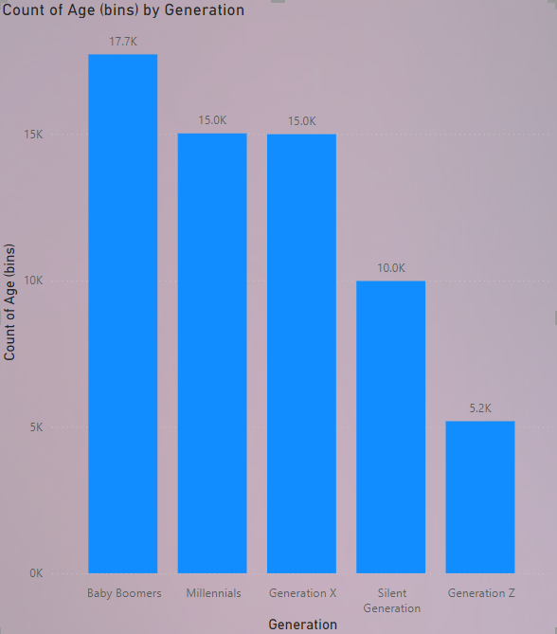
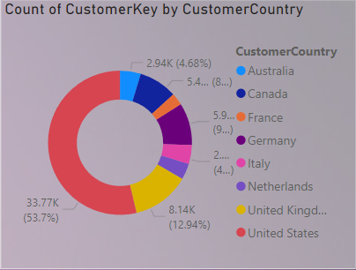
Comprehensive Customer Analysis: Insights from Age, Gender, and Country Distribution
Age Distribution: The dominance of Baby Boomers in the customer base, suggesting a need to tailor products and services to meet their needs.
Gender Balance: A relatively equal distribution of genders across most age groups, indicating potential for gender-neutral marketing strategies.
Geographic Concentration: The strong market presence of the United States, with opportunities for international expansion in other countries with significant customer counts.

Slide 6
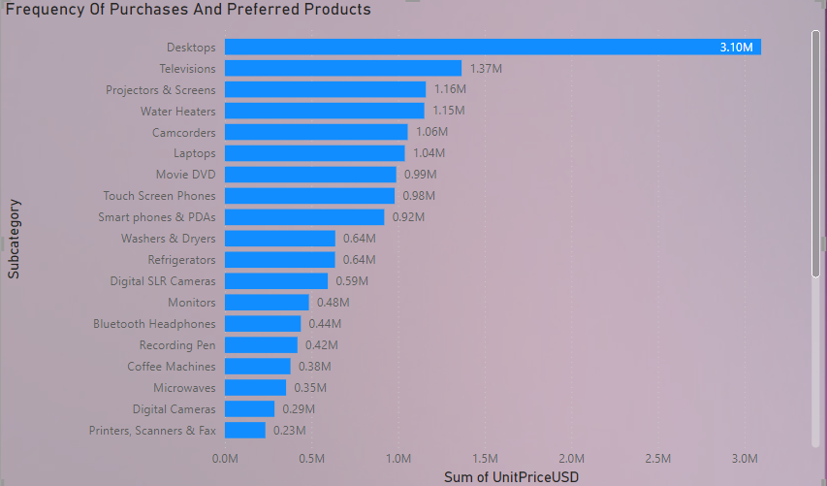
Customer Purchasing Trends and Product Preferences
Top-Selling Products:
Desktops emerge as the most popular product category, followed by Televisions and Projectors & Screens.
Analyzing the top-selling products can help businesses prioritize inventory, marketing efforts, and product development.
Product Clusters:
The chart reveals several clusters of related products with similar purchase frequencies, such as Electronics (Desktops, Televisions, Projectors & Screens, Camcorders, Laptops) and Home Appliances (Water Heaters, Washers & Dryers, Refrigerators, Microwaves).
Identifying these clusters can help businesses understand customer needs and cross-selling opportunities.
Niche Markets:
Products like Bluetooth Headphones, Recording Pens, and Coffee Machines have lower purchase frequencies but still represent a significant market.
Targeting these niche markets can provide opportunities for specialized products and services.

Slide 7
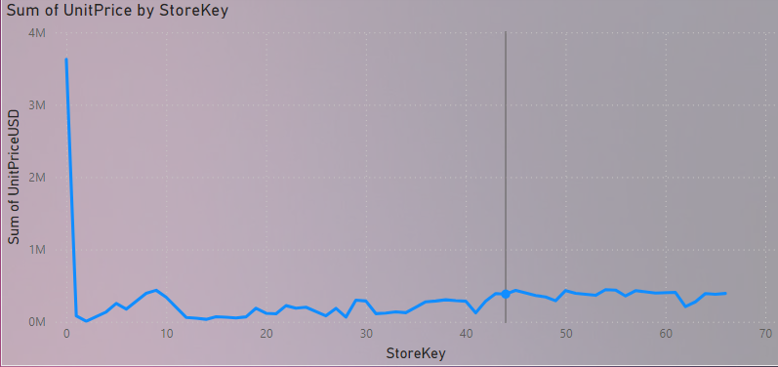
Analyzing Store Performance: A Deep Dive into Sales Revenue by StoreKey
Significant Sales Variation: The chart shows a wide range in sales revenue across different StoreKeys, indicating potential disparities in performance.
Outlier Identification: StoreKey 1 appears to be a significant outlier with exceptionally high sales, potentially requiring further investigation to understand the underlying factors.
Sales Fluctuations: The overall trend suggests fluctuations in sales revenue, potentially influenced by seasonal factors, marketing campaigns, or other external variables.
Data-Driven Decision Making: Analyzing this data can help identify high-performing stores, identify areas for improvement, and allocate resources more effectively.

Slide 8
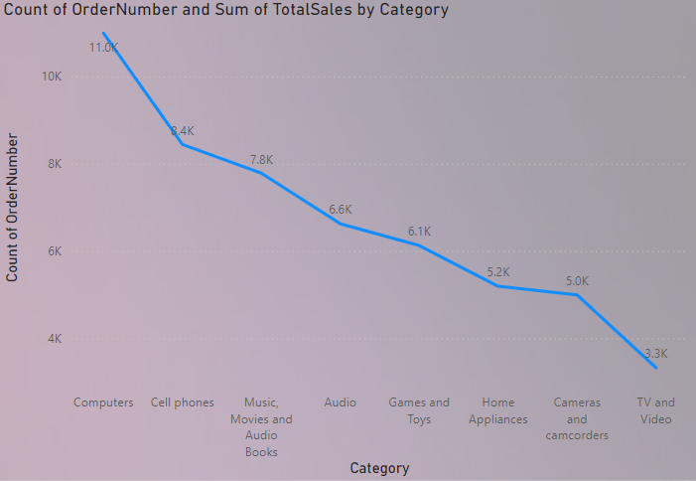
Product Performance Analysis: Insights into Sales, Profitability, and Category Trends
Top-Selling Categories: Computers, Home Appliances, and Cell Phones are the highest-selling categories.
Profit Margin Variation: Music, Movies & Audio have the highest profit margins, while Cell Phones and Games & Toys have lower margins.
Category Trends: Sales of Computers are declining, while Home Appliances are increasing.
Marketing Optimization: Consider optimizing marketing efforts for Music, Movies & Audio to boost sales.
Margin Improvement: Focus on improving profit margins for Cell Phones and Games & Toys through pricing strategies or cost reduction.

Slide 9
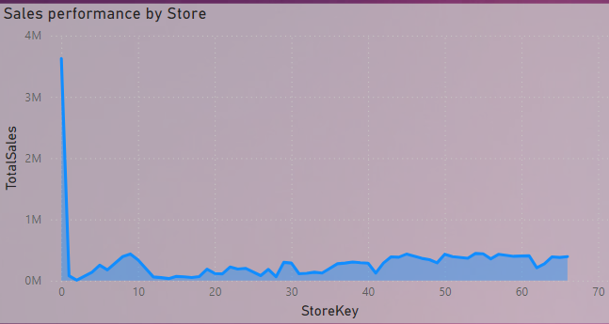
Store Analysis: Insights into Sales Performance, Location, and Size
Sales Variation: The chart reveals significant variations in sales performance across different stores, indicating potential disparities in factors such as location, size, or management practices.
High-Performing Stores: Identifying high-performing stores (e.g., StoreKey 1) can provide valuable insights into best practices and potential areas for replication.
Store Size Analysis: The donut chart shows a distribution of store sizes, suggesting that larger stores may have a higher overall sales volume but may not necessarily outperform smaller stores in terms of sales per square foot.
Regional Analysis: The map visualization provides a geographical overview of store locations and their corresponding sales performance, allowing for identification of regional trends and opportunities.
Store Age Analysis: Analyzing the relationship between store age and sales performance can help assess the impact of store maturity on revenue generation.

Slide 10
Conclusion
Customer Demographics: The customer base is dominated by Baby Boomers, with a relatively equal distribution of genders. Understanding these demographics is crucial for tailoring marketing strategies and products.
Geographic Concentration: The United States represents the largest customer base, followed by other English-speaking countries. Identifying opportunities in emerging markets can drive international growth.
Product Preferences: Desktops, televisions, and home appliances are popular product categories, while niche products like Bluetooth headphones and coffee machines have lower demand.
Store Performance: Significant variations exist in store performance, influenced by factors such as location, size, and management practices. Identifying high-performing stores and analyzing their characteristics can provide valuable insights for improvement.

Slide 11

Thank you
Santhosh Kumar S

